Slide 1
RAMACHANDRA COLLEGE OF ENGINEERING
(Autonomous)
UNIT-01
UNIT - I 8086/8088 MICROPROCESSORS :
A.RAMADEVI
ASSISTANT PROFESSOR

Slide 2
UNIT - I 8086/8088 MICROPROCESSORS :
Register organization of 8086,
Architecture,
signal capability, special purpose activities,
Minimum mode, maximum mode of 8086 system and timings,
machine language instructionformats
addressing mode of 8086,
instruction set of 8086
,assembler directives and operators).

Slide 3

What is a Microprocessor?
Computer's Central Processing Unit (CPU) built on a single Integrated Circuit (IC) is called
a microprocessor.
A digital computer with one microprocessor which acts as a CPU is called microcomputer.
It is a programmable, multipurpose, clock -driven, register-based electronic device that reads binary instructions from a storage device called memory, accepts binary data as input and processes data according to those instructions and provides results as output.
A microprocessor is an electronic component that is used It is a central processing unit on a single integrated circuit chip containing millions of very small components including transistors, resistors, and diodes that work together.
by a computer to do its work.

Slide 4
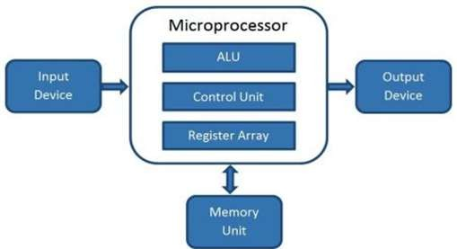
Working of Microprocessor:
A microprocessor consists of an ALU, control unit and register array. Where ALU performs arithmetic and logical operations on the data received from an input device or memory.
Control unit controls the instructions and flow of data within the computer. And, register array consists of registers which access the data very fast.

Slide 5
MPMC UNIT-2
CPU: The Central Processing Unit or CPU controls the operation of the computer. In a microcomputer the CPU is a microprocessor. The CPU or Microprocessor fetches binary ceded instructions from the memory, decodes the instructions into a series of simple actions, and carries out these actions in sequence of steps.
Address bus: The address bus consists of 16, 20, 24, or 32… parallel signal lines. These address lines are used to send a address of the memory location or a device address from the microprocessor unit to the memory or the peripheral. The address bus always unidirectional. Address always goes out of the microprocessor. The number of memory locations that the microprocessor can address is determined by the number of address lines. If the microprocessor has N address lines, then it can directly address 2^{N} memory locations. For ex: a microprocessor with 16 address lines can address 2¹⁶ or 65,536 memory locations.
Data bus: The data bus consists of 8,16,or 32…parallel lines .A group of lines used to transfer a data between the microprocessor and peripherals(or memory).The data bus is always bi-directional.
Control bus: The control bus consists of 4 to 10 parallel signal lines. The microprocessor sends out signals on the control bus to enable the outputs of addressed memory devices or port devices. Typical control bus signals are Memory Read, Memory Write, I/O Read, and I/O Write.
SOME IMPORTANT TERMS:
Microprocessor: It is a semiconductor device which is manufactured by using LSI or VLSI technology, which includes ALU, Control unit and a group of Registers in a single Integrated circuit.
Microcontroller: It is a device that includes microprocessor, memory, and I/O signal lines on a single chip, fabricated using VLSI technology.
Microcomputer: A digital computer having a microprocessor as its Central Processing Unit is called Microcomputer. So, a microprocessor combined with memory, an input device and an output device forms a microcomputer.
Bus: A group of wires or lines used to transfer bits between the microprocessor and other components of the computer system. Or a path used to carry signals, such as connection between memory and the microprocessor in a digital computer.
Hardware: The physical devices and circuitry of the computer is called Hardware.
Software: The programs written for the computer is referred to as software.
Firmware: The programs stored in ROMs or in other devices which permanently keep their stored information are referred as Firmware.
In general the width of the data bus is equal to the bit capacity of the microprocessor.
In general the internal architecture of the microprocessor depends on the bit capacity of the microprocessor.
  Bit-a binary digit.0 or 1
  Nibble-a group of four bits
  Byte-a group of eight bits
  Word-a group of 16 bits or a group of bits the computer recognizes and processes at a time.
  Double word-a group of 32 bits.
Instruction: A command in binary that is recognized and executed by the computer to accomplish a task. Some instructions are designed with one word, and some require multiple words.
Mnemonic: A combination of letters to suggest the operation of an instruction.

Slide 6
MPMC
Program: A set of instructions written in specific sequence for the computer to accomplish a given task.
UNIT-2
Machine language: The binary medium of communication with a computer through a designed set of instructions specific to each computer.
Assembly language: A medium of communication with a computer in which programs are written in mnemonics.
Low-level language: A medium of communication that is machine-dependant or specific to a given computer.
The machine and the assembly languages of a computer are considered low level languages.
Programs written in these languages are not transferable to different types of machines.
High-level language: A medium of communication that is independent of a given computer. Programs are written in English like words, and they can be executed on a machine using translator (a compiler or interpreter).
Source code: A program written either in mnemonics of as assembly language or in English like statements of high level language (before it is assembled or compiled).
Assembler: A computer program that translates an assembly language program from mnemonics to the binary machine code of a computer.
Compiler: A program that translates English-like words of a high level language into the machine language of a computer.
Interpreter: A program that translates the English –like statements of a high level language into the machine language of a computer.
Operating System: A set of programs that manages interaction between hardware and software.
ASCII: American Standard Code for Information Interchange. This is 7-bit alphanumeric code with 128 combinations.

Slide 7



APPLICATIONS OF MICROPROCESSORS:
Microprocessors are used in :
1.Calculators. 2.Accounting system.
3.Games machine.
4.Complex Industrial Controllers. 5Traffic light Control.
6.Data acquisition systems.

Slide 8

2.EVOLUTION OF MICROPROCESSORS
First Generation (4 - bit Microprocessors)
The first generation microprocessors were introduced in the year 1971-1972 by Intel Corporation. It was named Intel 4004 since it was a 4-bit processor.
It was a processor on a single chip. It could perform simple arithmetic and logical operations such as addition, subtraction, Boolean OR and Boolean AND.
It had a control unit capable of performing control functions like fetching an instruction from storage memory, decoding it, and then generating control pulses to execute it.

Slide 9
Second Generation (8 - bit Microprocessor)
The second generation microprocessors were introduced in 1973 again by Intel.
It was a first 8 - bit microprocessor which could perform arithmetic and logic
operations on 8-bit words.
It was Intel 8008, and another improved version was Intel 8088.
Third Generation (16 - bit Microprocessor)
The third generation microprocessors, introduced in 1978 were represented by Intel's 8086, Zilog Z800 and 80286, which were 16 - bit processors with a performance like minicomputers.

Slide 10
Fourth Generation (32 - bit Microprocessors)
Several different companies introduced the 32-bit microprocessors in around 1980, but the most popular one is the Intel 80386.
Fifth Generation (64 - bit Microprocessors)
From 1995 to now we are in the fifth generation.
After 80856, Intel came out with a new processor namely Pentium processor followed by Pentium Pro CPU, which allows multiple CPUs in a single system to achieve multiprocessing.
Other improved 64-bit processors are Celeron, Dual, Quad, Octa Core processors.

Slide 11
Functions of Microprocessor:
1.Controlling all other parts of the machine and sending timing signals. 2.Transferring data between memory and I/O devices.
Fetching data and instructions from memory.
Decoding instruction.
Performing arithmetical and logical operations. 6.Executing programs stored in memory.
7.Performing communication among the I/O devices etc.

Slide 12
Features of Microprocessor
Low Cost - Due to integrated circuit technology microprocessors are available at very low cost. It will reduce the cost of a computer system.
High Speed - Due to the technology involved in it, the microprocessor can work at very high speed. It can
execute millions of instructions per second.
Small Size - A microprocessor is fabricated in a very less footprint due to very large scale and ultra large scale
integration technology. Because of this, the size of the computer system is reduced.
Versatile - The same chip can be used for several applications, therefore, microprocessors are versatile.
Low Power Consumption - Microprocessors are using metal oxide semiconductor technology, which
consumes less power.
Less Heat Generation - Microprocessors uses semiconductor technology which will not emit much heat as
compared to vacuum tube devices.
Reliable - Since microprocessors use semiconductor technology, therefore, the failure rate is very less. Hence it is very reliable.
Portable - Due to the small size and low power consumption microprocessors are portable.

Slide 14
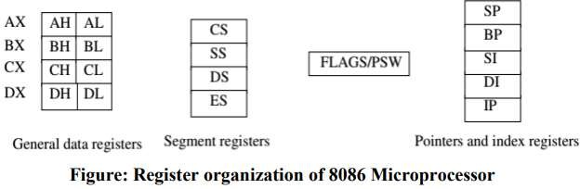
.REGISTER ORGANIZATION OF 8086 MICROPROCESSOR:
Register Organization
General purpose data registers
Segment Registers
Index and Point Registers
d) Flag Registers

Slide 15
a) General purpose data registers
Accumulator register (AX) consists of two 8-bit registers AL(Low-order byte) and AH(High-order byte), which can be combined together and used as a 16-bit register AX. AL in this case contains and AH contains, It holds operands and results during operation
Base register (BX) consists of two 8-bit registers BL(Low-order byte) and BH(High-order byte), which can be combined together and used as a 16-bit register BX .it holds the offset address in indirect addressing mode
Count register (CX) consists of two 8-bit registers CL(Low-order byte) and CH(High-order byte), which can be combined together and used as a 16-bit register CX. It holds count for instruction.
Data register (DX) consists of two 8-bit registers DL(Low-order byte) and DH(High-order byte), which can be combined together and used as a 16-bit register DX. It used with AX to holds 32bit values during MULTIPLICATION AND DIVIISII-IIIO_MNPMoCp_eUNraITt-0i1on.

Slide 16
b) Segment Registers
Code segment (CS) is a 16-bit register containing address of code segment(64KB) of
memory, where the executable program is stored.
Stack segment (SS) is a 16-bit register containing address of stack segment(64KB) of memory. which is used to store stack data i.e., subroutines or functions
Data segment (DS) is a 16-bit register containing address of data segment(64KB) of memory, where data is stored.
Extra segment (ES) is a 16-bit register containing address of extra segment(64KB) of
memory, where data is stored.

Slide 17
c) Index and Point Registers
Instruction Pointer (IP) is a 16-bit register. The IP register holds the Offset address of the next
instruction to be fetched from Code segment.
Stack Pointer (SP) is a 16-bit register. The SP register holds the Offset address of TOP of
STACK
SEGMENT.
Base Pointer (BP) is a 16-bit register. The BP register holds the Offset address of any random location OF STACK SEGMENT.
Source Index (SI) is a 16-bit register. The SI register holds the Offset address of DATA SEGMENT
Destination Index (DI) is a 16-bit register. The SI register holds the Offset address of EXTRA
SEGMENT

Slide 18
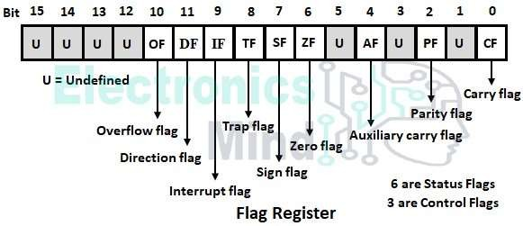
d) Flag Registers
8086 has 16-bit flag register, and there are 9 valid flag bits i.e., 6- status flags and 3-
control flags. The format of flag register is like below.

Slide 19
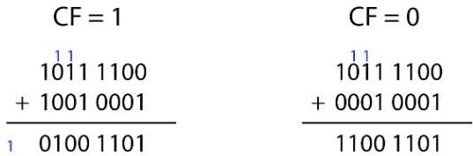
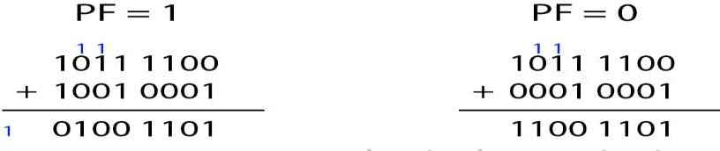
CF:CARRY FLAG
PF:PARITY FLAG
If PF = 1 ; it means it is even parity in the result ( there are even numbers
of 1’s ).
If PF = 0 ; it means it is odd parIiII-tIIy_.MPMC_UNIT-01

Slide 20
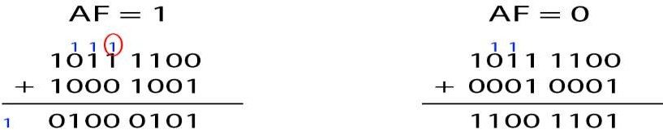
AF:AUXILARY FLAG
If AF = 1 ; there is a carry out from lower nibble.
If AF = 0 ;no carry out of lower nibble.
ZF:ZERO FLAG
This is zero flag. Whenever the output is 0 this flag is 1.
If ZF = 1 ; output is zero.
If ZF = 0 ; output is non zero.

Slide 21
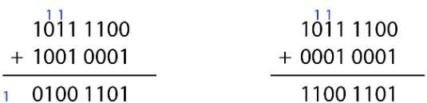
SF:SF stands for Sign Flag.
MSB = 1 , then it is +ve number
MSB = 0 , then it is -ve number. This is the reverse with the original case.
OF:The overflow flag is set to 1 when the result of a signed operation is too large to fit.

Slide 22
Flag Bit | Function
SF | Sign Flag-After any operation if the MSB is 1, then it indicates that the number is negative. And this flag is set to 1
ZF | Zero Flag-If the total register is zero, then only the Z flag is set
AF | Auxiliary Flag-When some arithmetic operations generates carry after the lower half and sends it to upper half, the AC will be 1
PF | This is even parity flag. When result has even number of 1, it will be set to 1, otherwise 0 for odd number of 1s
CF | This is carry flag. If some operations are generating carry after the operation this flag is set to 1
OF | The overflow flag is set to 1 when the result of a signed operation is too large ^{to fit.} III-II_MPMC_UNIT-01

Slide 23
Flag Bit | Function
DF | This is directional flag. This is used in string related operations. D = 1, then the string will be accessed from higher memory address to lower memory address, and if D = 0, it will do the reverse.
IF | This is interrupt flag. If I = 1, then MPU will recognize the interrupts from peripherals. For I = 0, the interrupts will be ignored
TF | This Trap flag is used for on-chip debugging. When T = 1, it will work in a single step mode. After each instruction, one internal interrupt is generated. It helps to execute some program instruction by instruction.T=0 NO EXECUTION IS PERFORMED.

Slide 24
3.ARCHITECTURE OF 8086 MICROPROCESSOR
https://www.youtube.co^{III}m^{-II_}/^{M}w^{PM}at^{C}c^{_U}h^{N}?^{IT}a⁻p⁰¹p=desktop&v=OvLRBSQ0Ja0

Slide 25
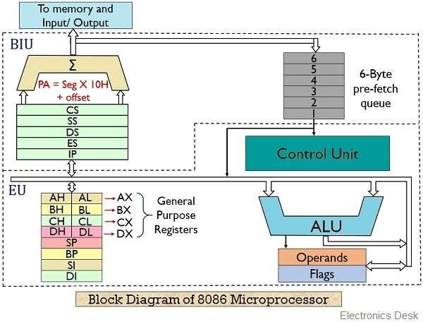



C-bus
Address summer
Instruction queue
Segment registers
Instruction pointer
A-bus
Offset registers
II

Slide 26

It is a 16 bit processor i.e., it process and operates 16 bit data at a time.
It is capable of working on 16 bits of information in one cycle or at a time.
8086 MICROPROCESSOR had16 bit data bus and size of the address bus is 20 bit
i.e., 2^ 20=1048576=1MB
8085 microprocessor fetch the instruction from memory and get inside the processor and then to execute that instruction then after go and fetch next instruction that drawback is over-come in 8086 microprocessor
In 8086 microprocessor fetch the instruction from memory and get inside the processor and while executes that instruction it will be fetching next instruction side by side it is done by using BIU & EU.In any processor to do
fetch
instruction
Decode
instruction
Executed that
decoded instruction

Slide 27
Who needs to calculate physical address ?
When ever EU executes an instruction at that time BIU wants to fetch next instruction from memory that’s why BIU need to calculate physical address.
✓
8086 MICROPROCESSOR
BUS INTERFACE UNIT(BIU)
EXECUTION UNIT(EU)

Slide 28
BIU is used to fetch the instructions from memory
BIU is used to calculate Physical Address
BIU is used to manage instruction Queue
Here, every instruction address it changes offset address not segment
address
Here, Code Segment(CS) GIVES STARTING ADDRESS
Here, Instruction Pointer(IP) always goes on increases give address i.e., offset address to next instruction.

Slide 29




Contains program
Memory is divided into 4 parts is
called as Segments.
Contains stack i.e.,
functions are allocated
Segments are presented in
memory
Segment registers are presented
in processor they contain address
of all the segments
Store random data
Processor calculate real address
or physical address

Slide 30
Why we calculate Physical address ?
For example do you know every location of your mobile phone or laptop it is very typical because we know like one folder inside one file that is virtual address it is not real address.
Every location has its own address or physical address.
To calculate Physical address by using the following formula
PHYSICAL ADDRESS=SEGMENT REGISTER ADDRESS*10H+OFFSET ADDRESS
Assume:
SEGMENT REGISTER ADDRESS=1000H
OFFSET ADDRESS=12345H
SO,PHYSICAL ADDRESS=1000H*10HIII+-II1_M2P3M4CH_U=N1IT2-03145H

Slide 31
Both CS,IP are used to fetch next instructions from memory through data bus.
Buses are three types:
Address bus gave address and code bus gave read signal to fetch the instruction from
memory through Data Bus.
BIU Fetching instructions in advance is called as pre-fetching from memory comes into Instruction Queue through data bus.
Instruction Queue it woks on First In First Out(FIFO).
So, In instruction queue , the instructions are move to Execution Unit and these instructions are executed continuous.

Slide 32
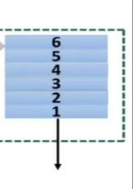
Instruction queue
INSTRUCTION QUEUE:
In instruction queue, it is a 6-byte instruction queue and it is used
to store pre fetching instruction from memory through data bus
Number of bytes in queue is 06 but each instruction size is not a single byte or all the instructions are not having same size and maximum size of the instruction is 6-Bytes.
Suppose one byte instruction is executed .so one byte is empty in queue but BIU
not do anything.
Now two bytes are empty BIU fetches instructions from memory and filled it or pre fetching instructions from memory through data bus.
Reason is 8086 microprocessor is a 16 bit processor.

Slide 33




MEMORY
INSTRUCTION QUEUE
CONTROL SYSTEMS
DECODE OR OPCODE
EXCUTION TAKES PLACE

Slide 34
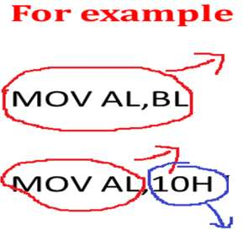
CONTROL SYSTEM/UNIT:
For example
OPCODE
MOV AL,BL here,BL comes to AL
OPCODE
OPCODE
MOV AL,10H here AL gets 10H
NUMBER IS NOT INCLUDED IN OPCODE
IT SPECIFIES FOR REGISTERS AND OPERATION
OPERAND
DECODE/OPCODE: it is used to convert ASSEMBLY LANGUAGE TO BINARY LANGUAGE. Microprocessor
is a middle level language i.e., ASSEMBLY LANGUAGE but processor couldn’t understand that language
because it knows machine language /binary language or 0’s & 1’s ONLY

Slide 35
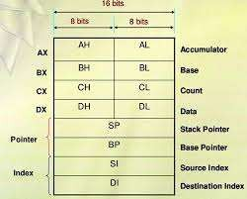



GENERAL PURPOSE REGISTERS:
EXAMPLE:
MOV AL,34H means AL 34H
MOV AH,12H means AH 12H
MOV AX,1234H means AH
34H AND AL 12H
EXAMPLE 1:
MOV BL,CL means BL CL
MOV BH,CH means BH CH
MOV CX,AX means CX AX
EXAMPLE 2:
MOV BL,04H
MOV CL,O5H
ADD BL,CL
INFORM TO GENERAL PURPOSE
REGISTERS BY CONTROL SYSTEM
ALU IS USED TOIII-IPI_EMRPFMOC_RUMNIT-A01RITHETIC AND LOGIC OPERATION

Slide 36
OPERAND REGISTERS :
It is a temporary register and it stores temporary values by processor.
Example:
XCHG BX,CX
here, exchange of two values by using temporary value that is stored into operand register.
FLAGS:
Each flag gives status of current register.

Slide 37
6.PIN DIAGRAM OF 8086 MICROPROCESSOR
III-II_MPMC_UNIT-01

Slide 38
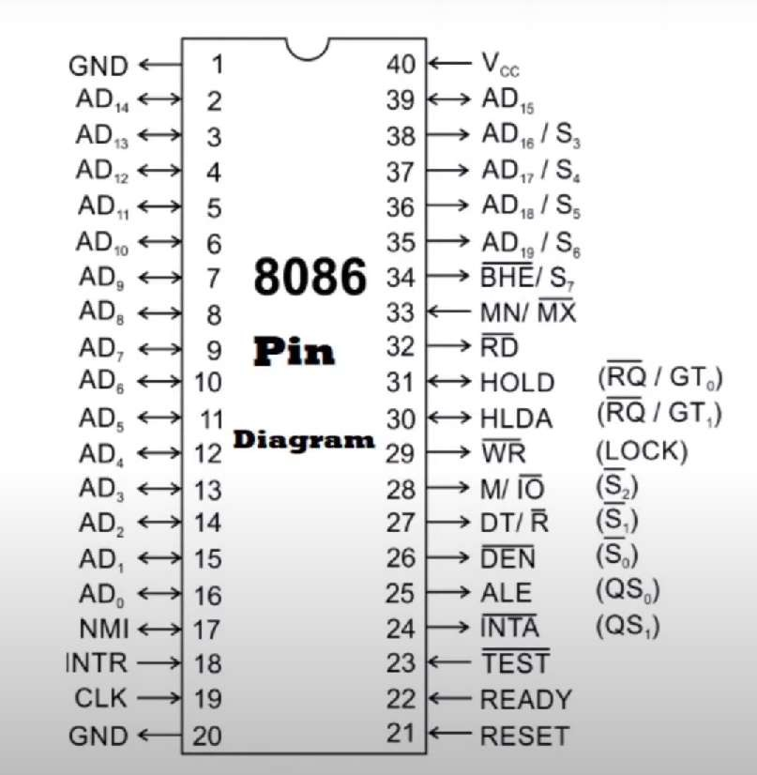
III-II_MPMC_UNIT-01

Slide 39
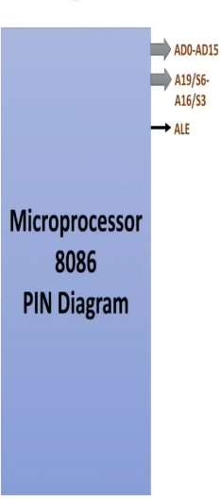
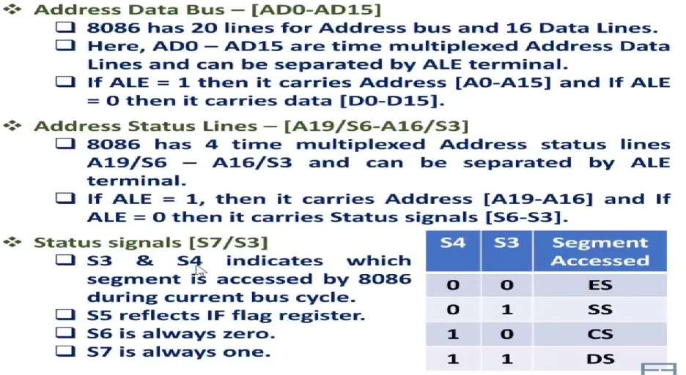
III-II_MPMC_UNIT-01

Slide 40
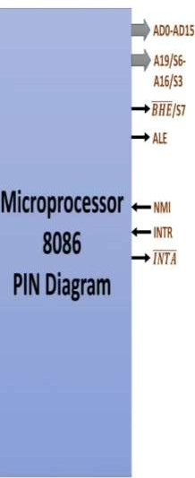
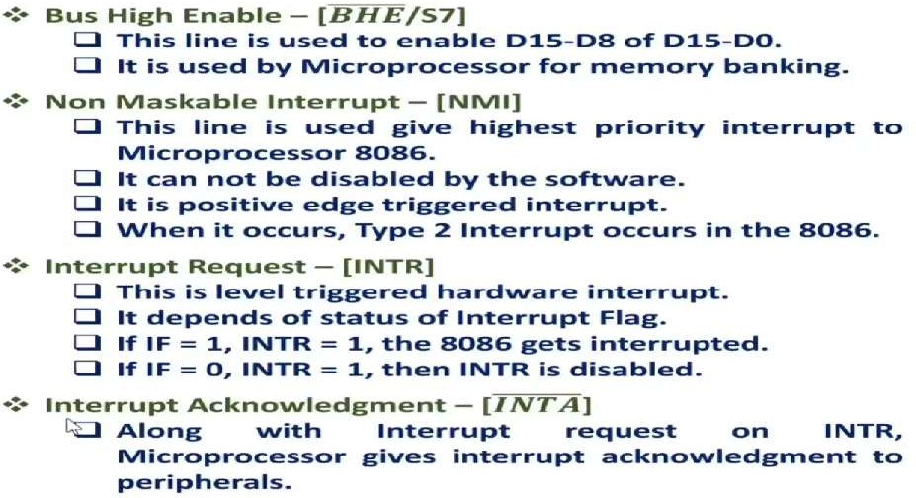

Slide 41
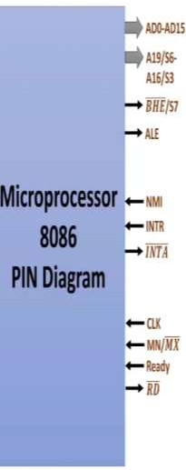
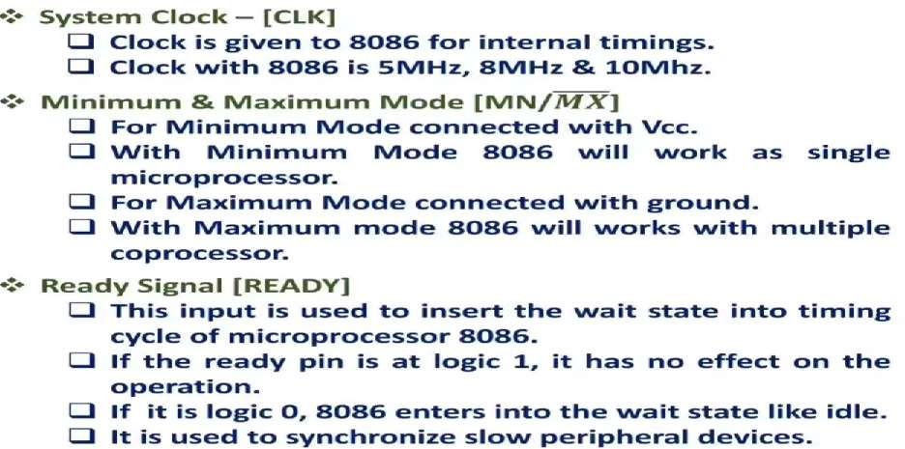

Slide 42
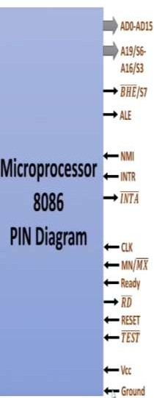
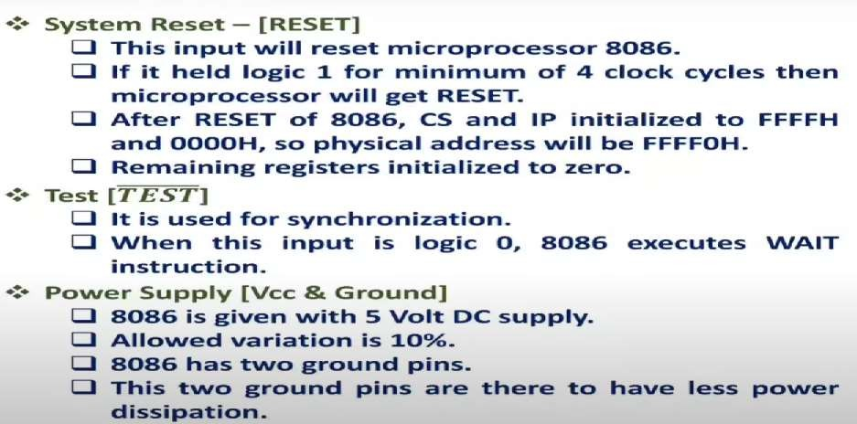
III-II_MPMC_UNIT-01

Slide 43
MINIMUM MODE(MN):IT IS ACTIVE HIGH SIGNAL
DT/R’:DATA TRANSMITT / DATA RECEIVED SIGNAL
DT=1 IS HIGH-DATA IS TRASMITTED OUT
R’=1 IS HIGH DATA IS RECEIVED IN
M/IO’:MEMORY/INPUT OUTPUT M=1 IS HIGH MEMORY IS ACCESSED
IO’=1 IS HIGH INPUT OUTPUTS ARE ACCESSED WR’:WRITE SIGNAL,IT IS A INPUT SIGNAL
IT IS A ACTIVE LOW SIGNAL AND WRITE DATA IN MEMORY
01

Slide 44
HLDA:HOLD ACKNOWLEDGE SIGNAL
IT IS ISSUED AFTER RECEIVING THE HOLD SIGNAL HOLD:WHEN MICROPROCESSOR RECIEVES HOLD SIGNAL,IT ISSUES HLDA SIGNAL TO DMA(DIRECT MEMORY ACCESS) CONTROLLER.

Slide 45
MAXIMUM MODE(MX’):
IT IS ACTIVE LOW SIGNAL
QS0,QS1:STATUS OF INSTRUCTION QUEUE
S0’,S1’,S2’:STATUS SIGNALS INDICATE THE OPERATION BEING DONE BY THE MICROPROCESSOR.
LOCK’=LOCK PIN,IT IS ACTIVE LOW SIGNAL
RQ’/GT0’ & RQ’/GT1’:REQUEST /GRAND PINS
OTHER PROCESSORS REQUEST CPU AND AFTER RECEIVING REQUEST CPU SEND ACKNOWLEDGE SIGNAL.
RD’:READ SIGNAL-OUTPUT SIGNAL

Slide 46
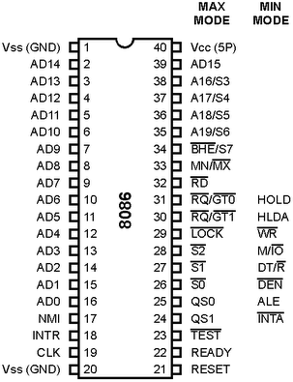

Slide 47
MINIMUM AND MAXIMUM MODE OPERATIONS

Slide 48
8086 has two operating Modes:
Minimum mode
Maximum mode
Minimum mode:
  In this 8086 is the only processor in the system . In a minimum mode 8086 system.
  8086 is operated in minimum mode when MN/MX’ pin to logic 1.
  In this mode, all the control signals are given out by the 8086 itself.
Maximum mode:
  In this we can connect more processors to 8086 (8087/8089).
  8086 max mode is basically for implementation of allocation of global resources and passing bus control to other coprocessor(i.e. second processor in the system), because two processors can not access system bus at same instant.
  All processors execute their own program.
  The resources which are common to all processors are known as global resources.
  The resources which are allocated to a particular processor are known as local or
private resources.

Slide 49
MINIMUM MODE OPERATION OF 8086

Slide 50
The 8086 microprocessor operates in minimum mode when MN/MX’ = 1.
In minimum mode,8086 is the only processor in the system which provides all the control signals which are needed for memory operations and I/O interfacing.
Here the circuit is simple but it does not support multiprocessing.
The other components which are transceivers, latches, 8284 clock generator, 74138 decoder, memory and i/o devices are also present in the system.
The address bus of 8086 is 20 bits long. By this we can access 2^20 byte memory
i.e. 1MB . Out of 20 bits, 16 bits A0 to A15(or 16 lines) are multiplexed with a data bus. By multiplexing, it means they will act as address lines during the first T state of the machine cycle and in the rest, they act as data lines. A16 to A19 are multiplexed S3 to S6 and BHE’ is multiplexed with S7.

Slide 51
Control signals provided by 8086 for memory operations and i/o interfacing :
They are used to identifying whether the bus is carrying a valid address or not , in which direction data is needed to be transferred over the bus, when there is valid write data on the data bus and when to put read data on the system bus.
Therefore, their sequence pattern makes all the operations successful in a particular machine cycle.
8282 (8 bits) latch :
The latches are buffered D FF. They are used to separate the valid address from the multiplexed Address/data bus by using the control signal ALE, which is connected to strobe(STB) of 8282. The ALE is active high signal. Here three such latches are
required because the addresis 20 bit

Slide 52
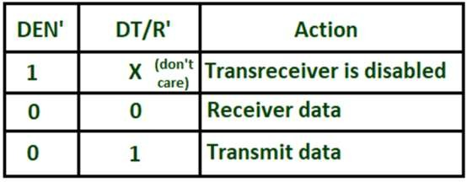
8286 (8 bits) transceivers :
They are bidirectional buffers and also known as data amplifiers. They are used to
separate the valid data from multiplexed add/data bus. Two such transceivers are needed because the data bus is 16 bits long. 8286 is connected to DT/R’ and DEN’ signals. They are enabled through the DEN signal .The direction of data on the data bus is controlled by the DT/R’ signal. DT/R’ is connected to T and DEN’ is connected to OE’.

Slide 53
8284 clock generator is used to provide the clock.
M/IO’= 1,then I/O transfer is performed over the bus. and when M/IO’ = 0, then I/O
operation is performed.
The signals RD’ and write WR’ are used to identify whether a read bus cycle or a write bus cycle is performing. When WR’ = 0 ,then it indicates that valid output data on the data bus.
RD’ indicates that the 8086 is performing a read data or instruction fetch process is occurring .During read operations, one other control signal is also used, which is DEN ( data enable) and it indicates the external devices when they should put data on the bus.
Control signals for all operations are generated by decoding M/IO’, RD’, WR’. They are decoded by 74138 3:8 decoder.

Slide 54
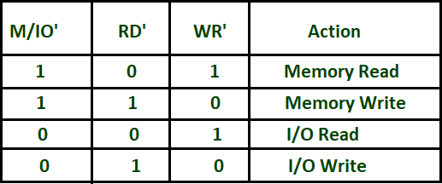
INTR and INTA :
When INTR = 1,then there is an interrupt to 8086 by other devices for their service. When INTA’= 0,then it indicates that the processor is ready to service them.
The bus request is made by other devices using the HOLD signal and the processor acknowledges them using the HLDA output signal.

Slide 55
Read Cycle
Timing diagram :
The working of min mode can be easily understood by timing diagrams.
All processors bus cycle is of at least 4 T-states(T₁,T₂,T₃,T₄) .The address is given by processor in the T1 state. It is available on the bus for one T-state.
In T_{2,} the bus is tristated for changing the direction of the bus( in the case of a data read cycle.)
The data transfer takes place between T₃ and T₄.
If the addressed device is slower, then the wait state is inserted between T₃ and T₄.

Slide 56
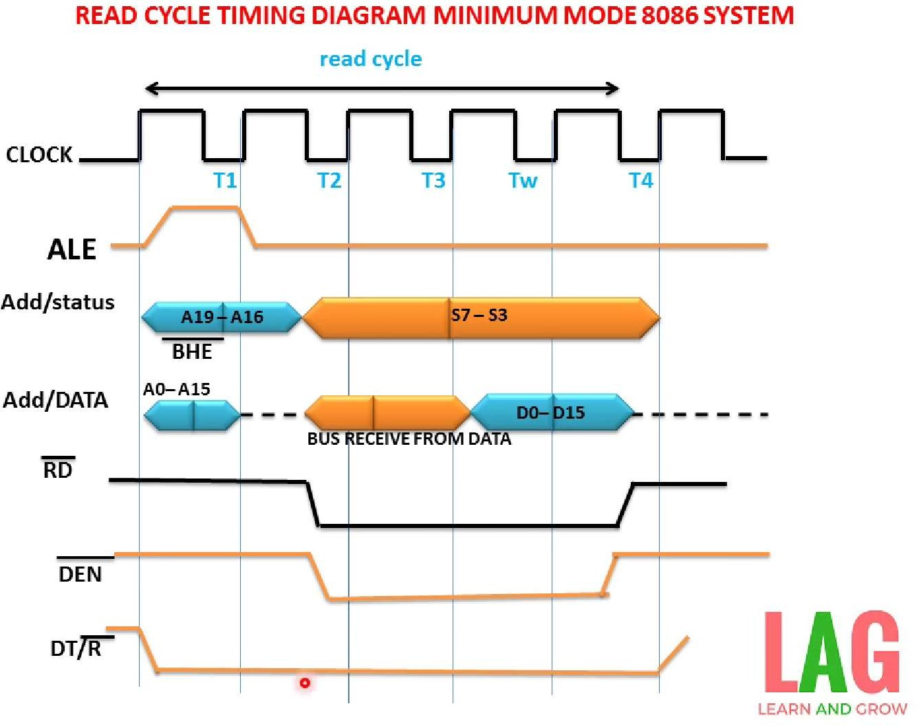



Slide 57
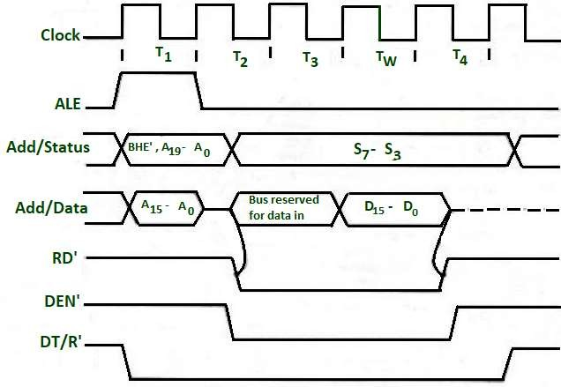

Slide 58
At T1 state ALE =1 ,this indicates that a valid address is latched on the address bus and
also M / IO’= 1, which indicates the memory operation is in progress.
In T2, the address is removed from the local bus and is sent to the addressed device.
Then the bus is tristated.
When RD’ = 0 , the valid data is present on the data bus.
During T2 DEN’ =0, which enables transceivers and DT/R’ = 0 ,which indicates that the data is received.
During T3, data is put on the data bus and the processor reads it.
The output device makes the READY line high. This means the output device has performed the data transfer process. When the processor makes the read signal to 1, then the output device will again tristate its bus drivers.

Slide 59
Write Cycle
At T1 state ALE =1 ,this indicates that a valid address is latched on the address
bus and also M / IO’= 1, which indicates the memory operation is in progress.
In T2, the processor sends the data to be written to the addressed location.
The data is buffered on the bus until the middle of T4 state.
The WR’=0 becomes at the beginning of T2.
The BHE’ and A0 signals are used to select the byte or bytes of memory or I/O
word.
During T2 DEN’ =0, which enables, transceivers and DT/R’ = 1 ,which indicates that the data is transferred by the processor to the addressed device.

Slide 60
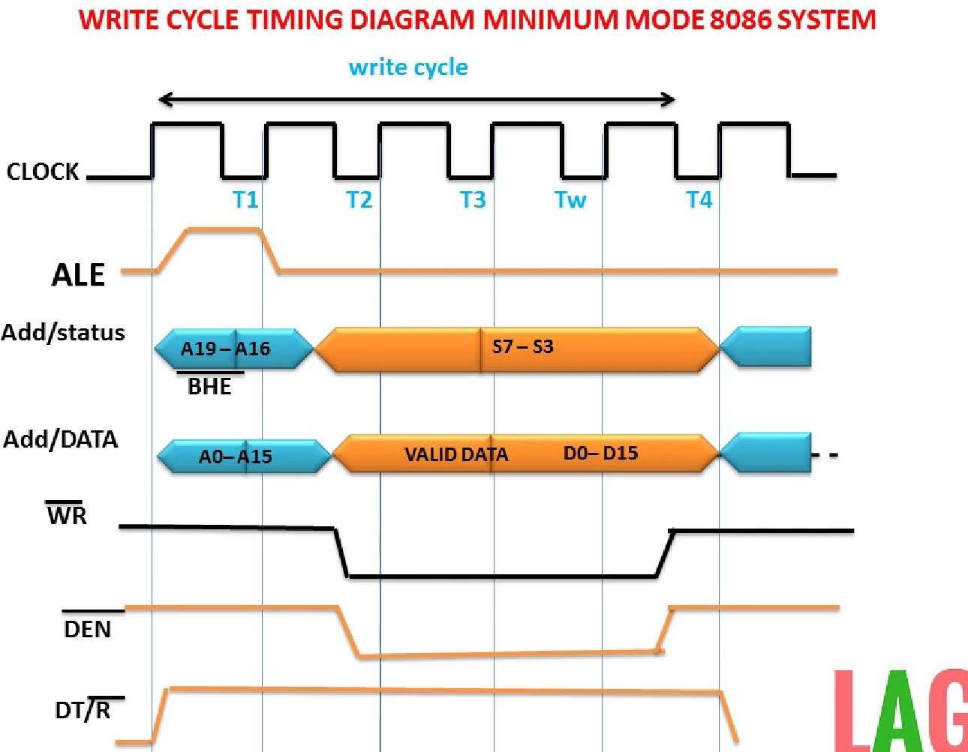

Slide 61
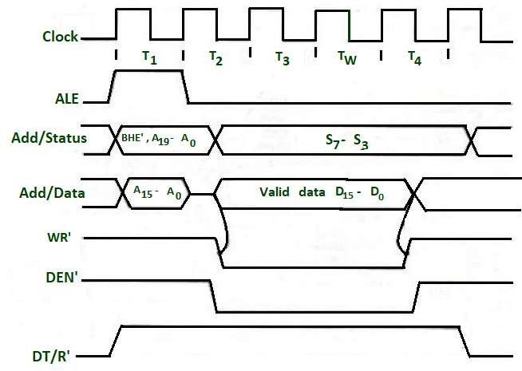

Slide 62
MAXIMUM MODE 8086 SYSTEM

Slide 63
When MN/ MX’ = 0 , 8086 works in max mode.
Clock is provided by 8284 clock generator.
8288 bus controller- Address form the address bus is latched into 8282 8-bit latch.
Three such latches are required because address bus is 20 bit.
The ALE(Address latch enable) is connected to STB(Strobe) of the latch. The ALE for
latch is given by 8288 bus controller.
The data bus is operated through 8286 8-bit transceiver.
Two such transceivers are required, because data bus is 16-bit. The transceivers are
enabled the DEN signal, while the direction of data is controlled by the DT/R signal.
DEN is connected to OE’ and DT/ R’ is connected to T. Both DEN and DT/ R’ are given
by 8288 bus controller.

Slide 64

Bus request is done using RQ’ / GT’ lines interfaced with 8086. RQ0/GT0 has
more priority than RQ1/GT1.
INTA’ is given by 8288, in response to an interrupt on INTR line of 8086.
In max mode, the advanced write signals get enabled one T-state in advance as compared to normal write signals. This gives slower devices more time to get ready to accept the data, therefore it reduces the number of cycles.

Slide 65
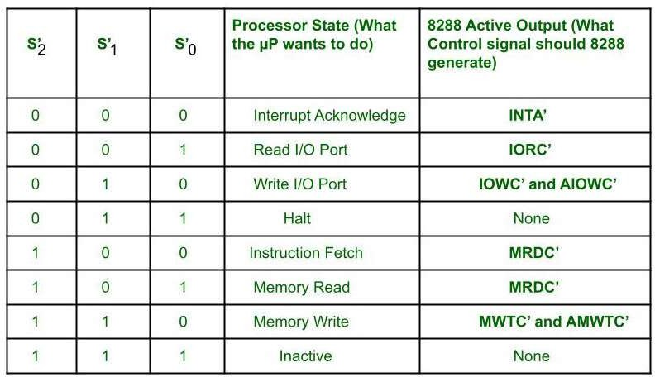

Slide 66
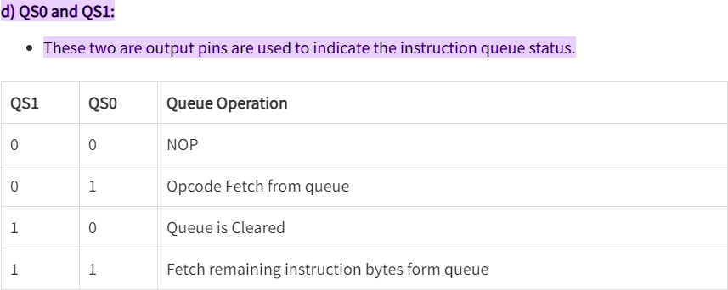

Slide 67
MRDC (Memory Read Command) : It instructs the memory to put the
contents of the addressed location on the data bus.
MWTC (Memory Write Command) : It instructs the memory to accept the
data on the data bus and load the data into the addressed memory location.
IORC (I/O Read Command) : It instructs an I/O device to put the data
contained in the addressed port on the data bus.
IOWC (I/0 Write Command) : It instructs an I/O device to accept the data on the data bus and load the data into the addressed port.

Slide 68
MCE/PDEN (Master Cascade Enable/Peripheral Data Enable) : It controls the mode
of operation of 8259. It selects cascade operation for 8259 (interrupt controller) if IOB signal is grounded and enables the I/O bus transceivers if IOB is tied high.
AEN, IOB and CEN : These pins are used in multiprocessor system. With a single processor in the system, AEN and IOB are grounded and CEN is tied high. AEN causes the 8288 to enable the memory control signals. IOB (I/O bus mode) signal selects either the I/O bus mode or system bus mode operation. CEN (control enable) input enables the command output pins on the 8288.
AIOWC/AMWC (Advance I/O Write Command/Advance Memory Write Command)
: These signals are similar to IOWC and MWTC except that they are activated one clock
pulse earlier. This gives slow interfaces an extra clock cycle to prepare to input the data.

Slide 69
S0,S1,S2 are set at the beginning of bus cycle. On detecting the change on
passive state S0 = S1 = S2 = 1, the 8288 bus controller will output a pulse on its ALE and apply a required signal to its DT/R pin during T1.
In T2, 8288 will set DEN = 1 thus enabling transceiver. For an input, 8288 it will activates MRDC or IORC. These signals are activated until T4. For an output, the AMWC or AIOWC is activated from T2 to T4 and MWTC or IOWC is activated from T3 to T4.
The status bits S0 to S2 remain active until T3, and become passive during T3 and T4.
If ready input is not activated before T3, wait state will be inserted between T3
and T4.

Slide 70
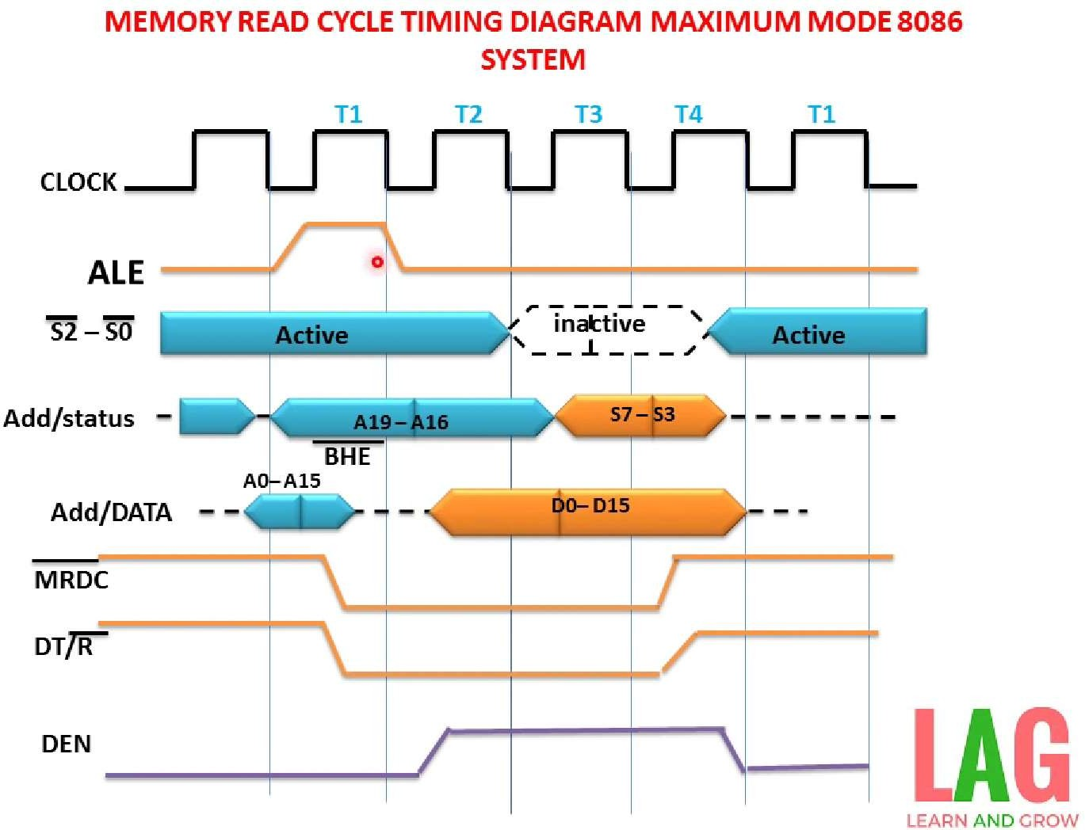

Slide 71
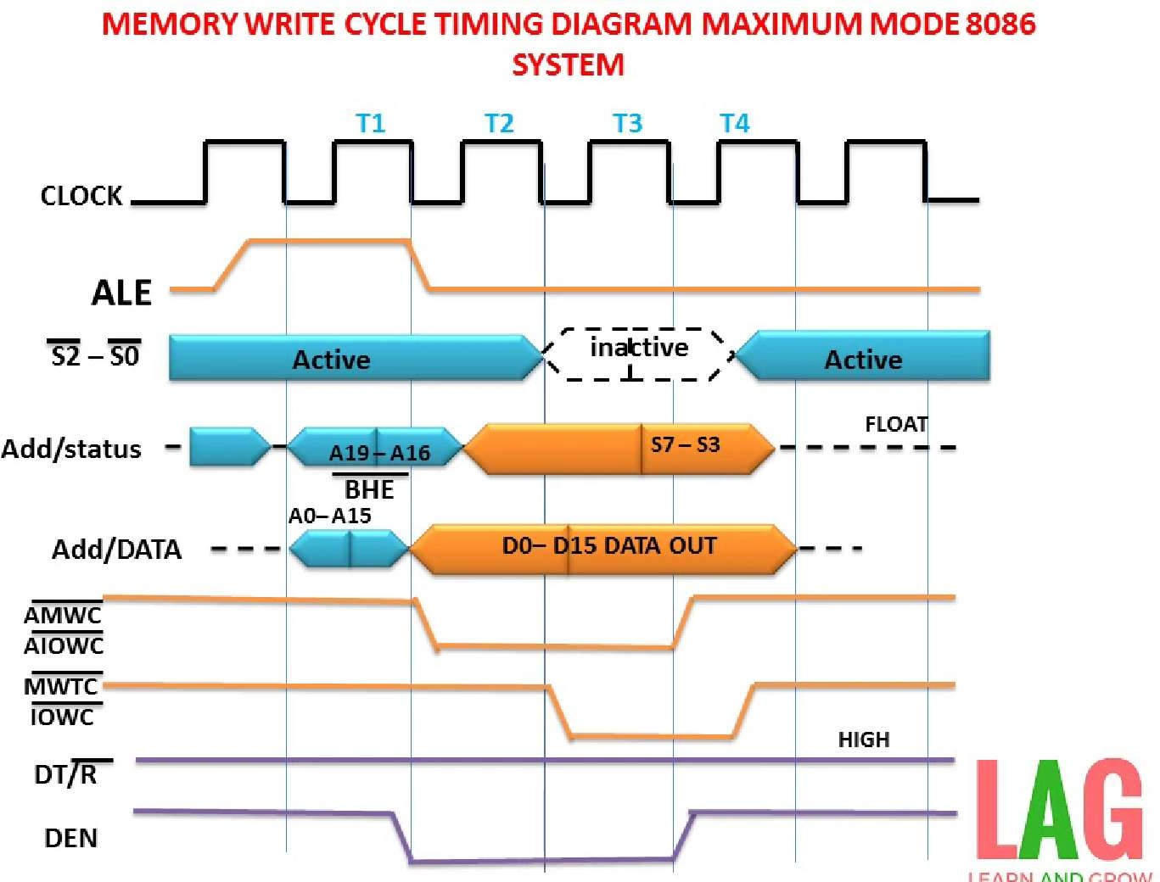

Slide 72



Slide 73
The method of specifying data to be operated by an
instruction is called as addressing mode.
The different ways that a processor can access the data are referred to as addressing modes.
Every instruction of a program has to operate on a data.
The different ways in which a source operand is denoted in an instruction are known as addressing modes.

Slide 74
Addressing Modes
8086 Microprocessor
Register Addressing
Immediate Addressing
Group I : Addressing modes for register
and immediate data
Direct Addressing Register Indirect Addressing Based Addressing Indexed Addressing Based Index Addressing String Addressing | Group II : Addressing modes for memory data
Direct I/O port Addressing Indirect I/O port Addressing | Group III : Addressing modes for I/O ports
11. Relative Addressing | Group IV : Relative Addressing mode
12. Implied Addressing | III-II_EEE-A_UNIT-II_MPMC_RAJEND_{G}RAroup V : Implied Addressing mode KODAMANCHILI

Slide 75
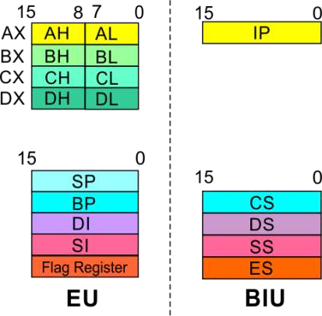

8086 Microprocessor
Group I : Addressing modes for register and
immediate data
1. Register Addressing
The instruction will specify the name of the register which holds the data to be operated by the instruction.
Immediate Addressing
Direct Addressing
Register Indirect Addressing
Based Addressing
Indexed Addressing
Based Index Addressing
String Addressing
Direct I/O port Addressing
Indirect I/O port Addressing
Example:
MOV CL, DH
The content of 8-bit register DH is moved to another 8-bit register CL
(CL) ← (DH)
Relative Addressing
Implied Addressing

Slide 76
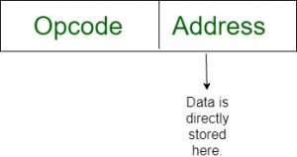
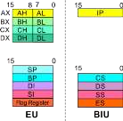
8086 Microprocessor
Group I : Addressing modes for register and
immediate data
1. Register Addressing
2. Immediate Addressing
In immediate addressing mode, an 8-bit or 16-bit data is specified as part of the instruction
Direct Addressing
Register Indirect Addressing
Based Addressing
Indexed Addressing
Based Index Addressing
String Addressing
Direct I/O port Addressing
Indirect I/O port Addressing
Example:
MOV DL, 08H
The 8-bit data (08_{H}) given in the instruction is
moved to DL
(DL) ← 08_{H}
MOV AX, 0A9FH
The 16-bit data (0A9F_{H}) given in the instruction is moved to AX register
11. Relative Addressing
(AX) ← 0A9F_{H}
12. Implied Addressing

Slide 77
8086 Microprocessor
Group II : Addressing modes for memory
data
Register Addressing
Immediate Addressing
3. Direct Addressing
Here, the effective address of the memory location at which the data operand is stored is given in the instruction.
The effective address is just a 16-bit number
written directly in the instruction.
Register Indirect Addressing
Based Addressing
Indexed Addressing
Based Index Addressing
String Addressing
Direct I/O port Addressing
Indirect I/O port Addressing
Example:
MOV BX, [1354H] MOV BL, [0400H]
The
square brackets
around the 1354_{H} denotes
the
contents of the memory
location. When
executed, this instruction will copy the contents of
11. Relative Addressing
the memory location into BX register.
12. Implied Addressing
This addressing mode is called
direct because
the
displacement of the operand from the segment
base is specified directly in the instruction.

Slide 78
8086 Microprocessor
Group II : Addressing modes for memory
data
In Register indirect addressing, name of the
1. Register Addressing
register which holds the
effective address (EA)
2. Immediate Addressing
will be specified in the instruction.
3. Direct Addressing
Registers used to hold EA are any of the following registers:
4. Register Indirect Addressing
Based Addressing
Indexed Addressing
Based Index Addressing
String Addressing
Direct I/O port Addressing
Indirect I/O port Addressing
BX, BP, DI and SI.
Content of the
DS register
is used for
base
address calculation.
Example:
Note : Register/ memory enclosed in brackets refer to content of register/ memory
MOV CX, [BX]
Operations:
EA = (BX)
BA = (DS) x 16₁₀ MA = BA + EA
(CX) ← (MA) or,
(CL) ← (MA)
(CH) ← (MA +1)
11. Relative Addressing
12. Implied Addressing

Slide 79
8086 Microprocessor
Group II : Addressing modes for memory
data
1. Register Addressing
Based Addressing Mode
Based Addressing specifies a signed 8-bit or an unsigned 16-bit displacement and stores the base
2. Immediate Addressing
3. Direct Addressing
4. Register Indirect Addressing
value for the effective address in BX or BP.
5. Based Addressing
When there is an 8-bit displacement, the sign is 16-
Indexed Addressing
bit extended before being added to the base value.
Based Index Addressing
MOV AX, [BX + 04]
Given instruction indicates that there is a value stored in the BX register and this is added with 4 bits displacement value and will store in the AX register.
8. String Addressing
Direct I/O port Addressing
Indirect I/O port Addressing
11. Relative Addressing
12. Implied Addressing

Slide 80
8086 Microprocessor
Group II : Addressing modes for memory
data
1. Register Addressing
Indexed Mode
The SI or DI register stores the index value for memory data, and the instruction will specify either a signed 8-bit or an unsigned 16-bit
displacement.
To produce the EA, displacement is added to the index value in the SI or DI register.
MOV CX, [SI + 16]
Given instruction indicates that there is a value stored in the SI (Source Index) register and this is added with 16 bits displacement value and will store in the BX register.
2. Immediate Addressing
3. Direct Addressing
4. Register Indirect Addressing
5. Based Addressing
6. Indexed Addressing
Based Index Addressing
String Addressing
Direct I/O port Addressing
Indirect I/O port Addressing
11. Relative Addressing
12. Implied Addressing

Slide 81
8086 Microprocessor
Group II : Addressing modes for memory
data
1. Register Addressing
2. Immediate Addressing
Based Indexed Mode
3. Direct Addressing
In the based index addressing of 8086, a base register (BX
4. Register Indirect Addressing
or BP), an index register (SI or DI), and a displacement are
5. Based Addressing
6. Indexed Addressing
added to determine the effective address.
7. Based Index Addressing
Examples of Based Indexed Addressing Modes are given
String Addressing
Direct I/O port Addressing
Indirect I/O port Addressing
below.
MOV DX, [BX + SI]
11. Relative Addressing
Given instruction indicates that there is a value stored in
12. Implied Addressing
the SI (Source Index) register and this is added to the
value of the BX register and will store in the DX register.

Slide 82
Based Indexed Displacement Mode
MOV AX, [BX+SI+08]
Given instruction indicates that there is a value stored in the SI (Source Index) register and this is added to the value of the BX register along with the 8-bit displacement value and will store in the AX register.

Slide 83
8086 Microprocessor
Group II : Addressing modes for memory
data
This addressing mode is related to string
instructions. In this the value of SI and DI are auto
1. Register Addressing
2. Immediate Addressing
3. Direct Addressing
4. Register Indirect Addressing
incremented and decremented depending upon the
5. Based Addressing
6. Indexed Addressing
value of directional flag.
7. Based Index Addressing
8. String Addressing
Direct I/O port Addressing
Indirect I/O port Addressing
Example:
11. Relative Addressing
MOVS B
12. Implied Addressing
MOVS W
Note : Effective address of the Extra segment register

Slide 84
8086 Microprocessor
Group III : Addressing modes for I/O
ports
1. Register Addressing
IN AL, [80H]
2. Immediate Addressing
3. Direct Addressing
It reads one byte of data from I/O port address
4. Register Indirect Addressing
5. Based Addressing
80H to AL
Indexed Addressing
Based Index Addressing
String Addressing
Direct I/O port Addressing
Indirect I/O port Addressing
OUT [82H], AL
11. Relative Addressing
It sends one byte of data from AL to I/O port
12. Implied Addressing
address 82H

Slide 85
8086 Microprocessor
Group IV : Relative Addressing
mode
1. Register Addressing
In this addressing mode, the effective address of a program instruction is specified relative to Instruction Pointer (IP) by an 8-bit signed displacement.
2. Immediate Addressing
3. Direct Addressing
4. Register Indirect Addressing
Example: JZ 0AH
5. Based Addressing
Jump if
zero
6. Indexed Addressing
7. Based Index Addressing
JNZ Jum if not zero
8. String Addressing
Direct I/O port Addressing
Indirect I/O port Addressing
JNC Jum if not carry
If ZF = 1, then the program control jumps to
11. Relative Addressing
new address calculated above.
12. Implied Addressing
If ZF = 0, then next instruction
program is executed.
I
of the

Slide 86
8086 Microprocessor
Group IV : Implied Addressing
mode
1. Register Addressing
2. Immediate Addressing
In this Addressing
implied in instruction
mode, the operand is
3. Direct Addressing
4. Register Indirect Addressing
5. Based Addressing
Example: CLC
6. Indexed Addressing
7. Based Index Addressing
This clears the carry flag to zero.
8. String Addressing
STC
Direct I/O port Addressing
Indirect I/O port Addressing
Set the carry flag
11. Relative Addressing
CLD
12. Implied Addressing
Clear directional flag

Slide 87

Find Physical Address ???

Slide 88
Determine the physical address when CS=5300H and IP=0200H
Determine the physical address when ES=6500H and IP=4767H
Determine the physical address when CS=24F6H and IP=634AH
DS locate physical address of 43657H. Assume IP is 2057H
What is the componenet of data segment DS to locate the Physical address of
43657H.Assume the content of IP is 2057H

Slide 89



8086 MICROPROCESSOR MODES OF OPERATION

Slide 90
8086 has two operating Modes:
Minimum mode
Maximum mode
Minimum mode:
  In this 8086 is the only processor in the system . In a minimum mode 8086 system.
  8086 is operated in minimum mode when MN/MX’ pin to logic 1.
  In this mode, all the control signals are given out by the 8086 itself.
Maximum mode:
  In this we can connect more processors to 8086 (8087/8089).
  8086 max mode is basically for implementation of allocation of global resources and passing bus control to other coprocessor(i.e. second processor in the system), because two processors can not access system bus at same instant.
  All processors execute their own program.
  The resources which are common to all processors are known as global resources.
  The resources which are allocated to a particular processor are known as local or
private resources.

Slide 91



INSTRUCTIONS OF 8086
OR INSTRUCTION SETS OF 8086

Slide 92
An instruction is a binary pattern designed inside a
microprocessor to perform a specific function.
The entire group of instructions that a microprocessor supports is called Instruction Set.
8086 has more than 20,000 instructions.

Slide 93
The 8086 microprocessor supports 8 types of instructions −
Arithmetic Instructions
Data Transfer Instructions
Logical Instructions
Control Transfer Instructions
String Manipulation Instructions
Processor Control Instructions

Slide 94
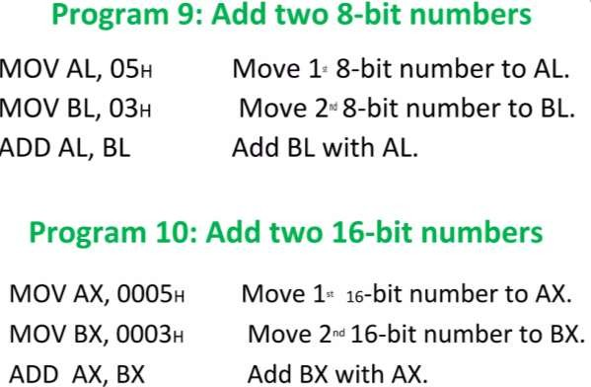
1.Arithmetic instructions in 8086 microprocessor
Arithmetic Instructions are the instructions which perform basic arithmetic
operations such as addition, subtraction and a few more.
Following is the table showing the list of arithmetic instructions:
I

Slide 95
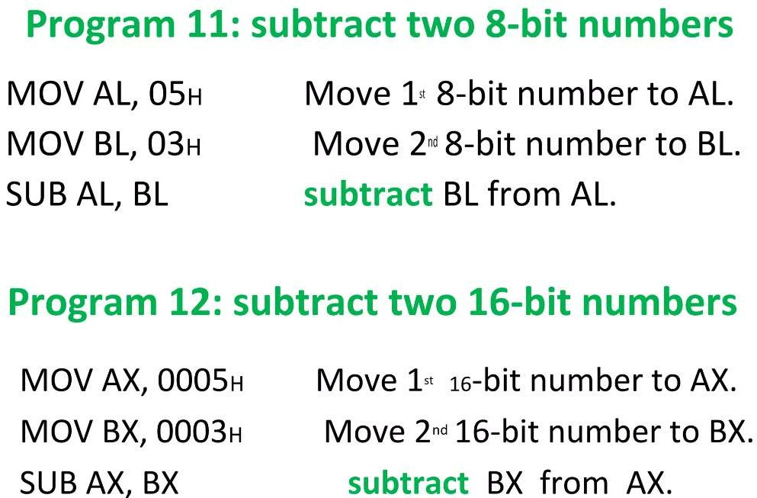

Slide 96
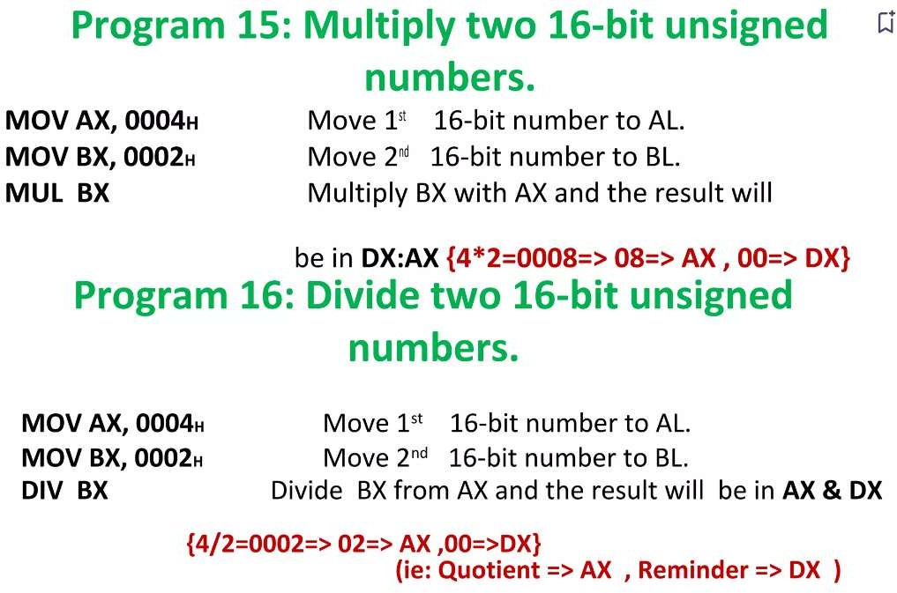

Slide 97
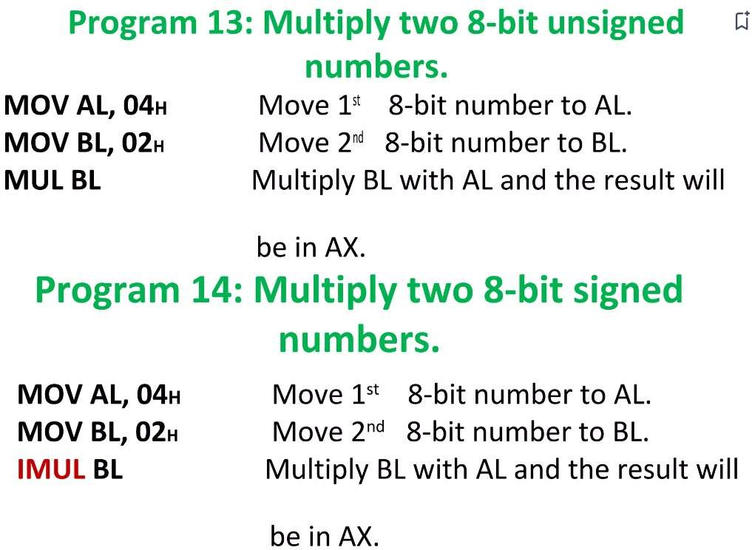

Slide 98
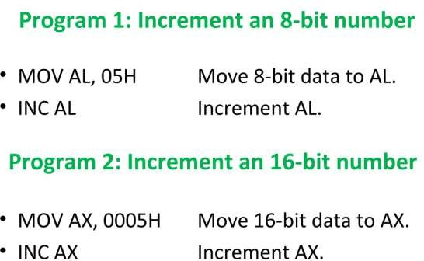
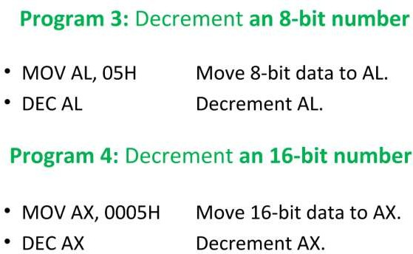

Slide 99
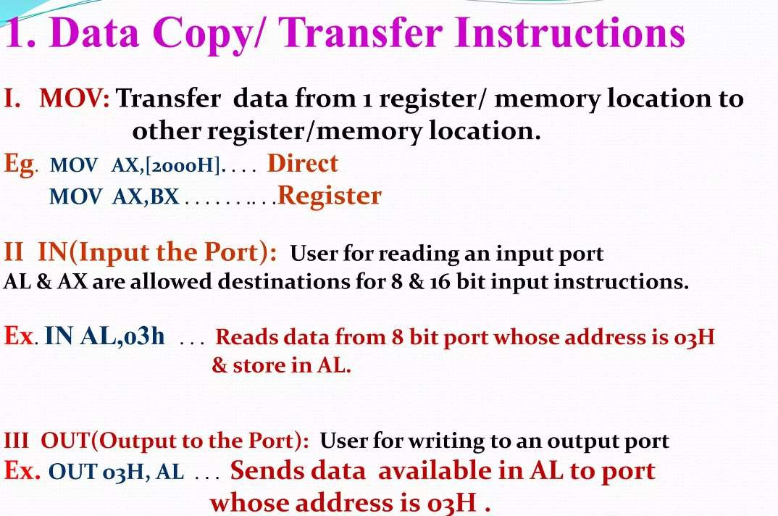
2

Slide 100
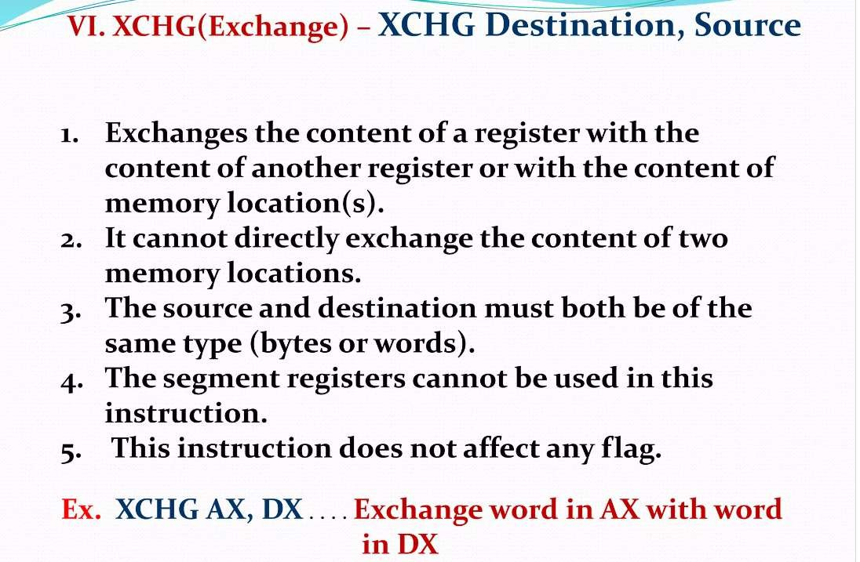

Slide 101
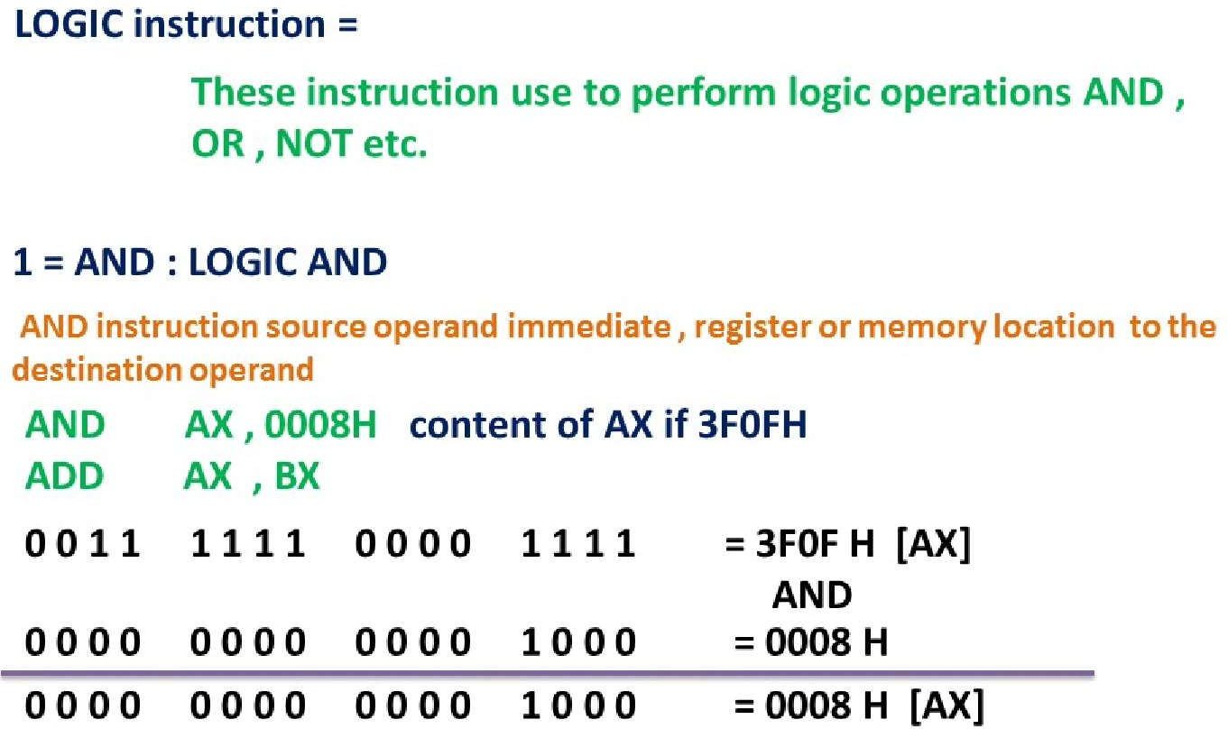
3.Logical Instructions

Slide 102
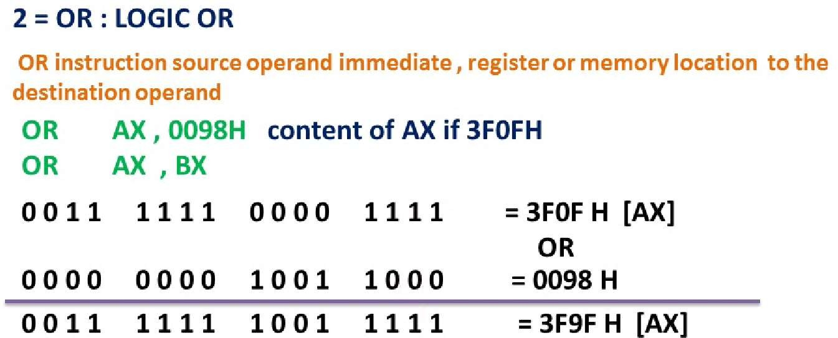
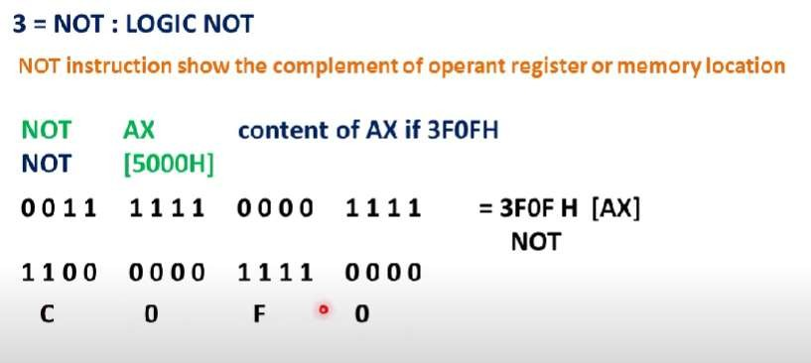
III-

Slide 103
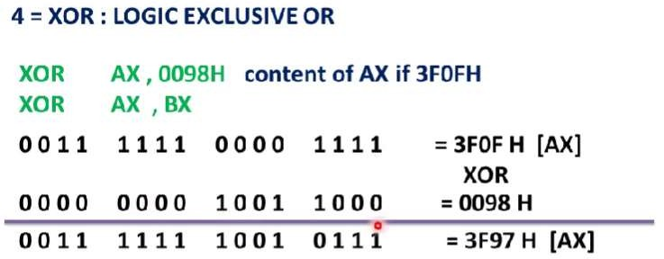
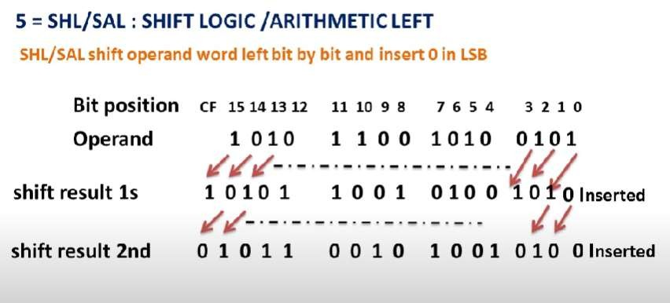
I

Slide 104
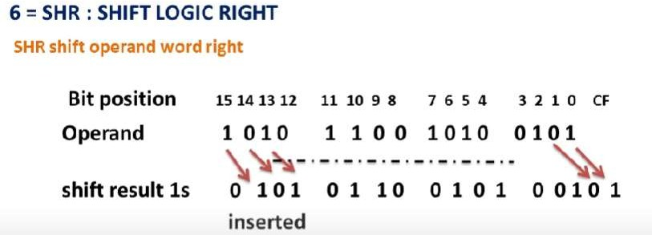

Slide 105
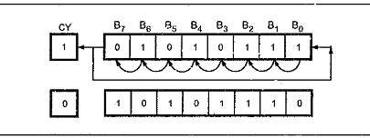
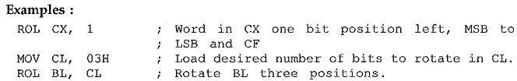
7.ROL Des, Count:
It rotates bits of byte or word left, by count.
MSB is transferred to LSB and also to CF.

Slide 106


8.ROR Des, Count:
It rotates bits of byte or word right, by count.
LSB is transferred to MSB and also to CF.

Slide 107
4.Control Transfer Instructions
These instructions cause change in the sequence of the execution of instruction.
This change can be through a condition or sometimes unconditional.
The conditions are represented by flags.

Slide 108
CALL Des:
  This instruction is used to call a subroutine or function or procedure.
  The address of next instruction after CALL is saved onto stack.
RET:
  It returns the control from procedure to calling program.
  Every CALL instruction should have a RET.
JMP Des:
  This instruction is used for unconditional jump from one place to another.
Jxx Des (Conditional Jump):
  All the conditional jumps follow some conditional statements or any
instruction that affects the flag.

Slide 109
Conditional Jump Table
Mnemonic | Meaning | Jump Condition
JA | Jump if Above | CF = 0 and ZF = 0
JAE | Jump if Above or Equal | CF = 0
JB | Jump if Below | CF = 1
JBE | Jump if Belowor Equal | CF = 1 or ZF = 1
JC | Jump if Carry | CF = 1
JE | Jump if Equal | ZF = 1
JNC | Jump if Not Carry | CF = 0
JNE | Jump if Not Equal | ZF = 0
JNZ | Jump if Not Zero | ZF = 0
JPE | Jump if Parity Even | PF = 1
JPO | Jump if Parity Odd | PF = 0
JZ | Jump if Zero | ZF = 1

Slide 110
5.String Manipulation Instructions
String in assembly language is just a sequentially stored bytes or
words.
There are very strong set of string instructions in 8086.
By using these string instructions, the size of the program is considerably reduced.

Slide 111
CMPS Des, Src:
  It comparesthe string bytes or words.
SCAS String:
  It scans a string.
  It comparesthe String with byte in AL or with word in AX.
MOVS / MOVSB / MOVSW:
  It causes moving of byte or word from onestring to another.
  In this instruction, the source string is in Data Segment and destination string is in
Extra Segment.
  SI and DI store the offsetvalues for source and destination index.

Slide 112
6.Processor Control Instructions
These instructions control the processor itself.
8086 allows to control certain control flags that:
causes the processing in a certain direction
processor synchronization if more microprocessor attached.
than one

Slide 113
STC:
  It sets the carry flag to 1.
CLC:
  It clears the carry flag to 0.
CMC:
  It complements the carry flag.
STD:
  It sets the direction flag to 1.
  If it is set, string bytes are accessed from higher memory address to lower
memory address.
CLD:
  It clears the direction flag to 0.
  If it is reset, the string bytes are accessed from lower memory address
to higher memory address.

Slide 114
Assembler Directives
Data Definition Directives:
  DB (Define Byte)
  DW (Define Word)
  DD (Define Doubleword)
  DQ (Define Quadword)
Segment Declaration Directives:
  SEGMENT
  ENDS
Procedure Declaration Directives:
  PROC
  ENDP
Assembly Control Directives:
  ASSUME
  END

Slide 116
ASSEMBLER DIRECTIVES
4
_{Assembler} directives are the commands to the assembler that direct the assembly ^{process.}
_{4 They} indicate how an operand is treated by the assembler and how assembler handles ^{the program.}
6 They also direct the assembler how program and data should arrange in the memory. ñ ALP's are composed of two type of statements.
The instructions which are translated to machine codes by assembler.
The directives that direct the assembler during assembly process, for which no machine code is generated.
1. ASSUME: Assume logical segment name.
The ASSUME directive is used to inform the assembler the names of the logical segments to be assumed for different segments used in the program .In the ALP each segment is given name.
Syntax: ASSUME segreg:segname,...segreg:segname
Ex: ASSUME CS:CODE
ASSUME CS:CODE,DS:DATA,SS:STACK

Slide 117
DB: Define Byte
The DB directive is used to reserve byte or bytes of memory IOEations in the available memory.
Syntax: Name of variable DB initialization value. Ex: MARXS DB 35H,30H,35H,40H
NAME DB "VARDHAMAN"
DW: Define Word
The DW directive serves the same puposes as the DB directive,but it now makes the assembler reserve the number of memory words[16-bit) instead of bytes.
Syntax: variable name DW initialization values. Ex. WORDS DW 1234H,4567H,2367H
WDATA DW 5 Dup(522h)
(or) Dup(?)
OD: Define Double:
The directive DD is used to define a double word (4bytes) variable.
Syntax: variablename DD 12345678H Ex: Data1 DD 12345678H
DQ: Define Quad Word
This directive is used to direct the assembler to reserve 4 words (8 bytes) of memory for the specified variable and may initialize it with the specified values.
Syntax: Name of variable DQ initialize values. Ex. Data1 DQ 123456789ABCDEF2H
DT: Define Ten Bytes
The DT directive directs the assemb1er to define the specified variable requiring 10 bytes for its storage and initialize the 10-bytes with the specified values.
Syntax: Name of variable DT initialize values. Ex: Data1 DT 123456789ABCDEF34567H
END: End of Program
The END directive marks the end of an ALP. The statement ner the directive ENO will be ignored by the assembler.
ENDP: End of Procedure
The ENDP directive is used to indicate the end of proEedure. In the AL programming the subroutines arB EBIIBd procedures.
Ex: Procedure Start
Start ENDP

Slide 118
9. ENDS: End of segment
The ENDS directive is used to indicate the end of segment. Ex: DATA SEGMENT
DATA ENDS
10.EVEN: Align on Even memory address
The EVEN directives updates the location counter to the next even address. Ex: EV£N
Procedure Stan
Start ENDP
4 The above structure shows a procedure START that is to be aligned at an even address,
EQU: Equate
The directive EQU is used to assign a label with a value or symbol. Ex: LABEL EQU OSOOH
ADDITION EQU ADD
EXTRN: External and public
& The directive EXTRN informs the assembler that the names, procedures and labels declared after this directive have been already defined In some other AL modules.
& While in other module, where names, procedures and labels actually appear, they must be deElared publiE using the PUBLIC directive.
Ex: MODULE1 SEGMENT PUBLIC FACT FAR MODULE1 ENDS
MODULE2 SEGMENT EXTRN FACT FAR
MODULE2 END
GROUP: Group the related segments
This directive is used to form logical groups of segments with similar purpose or type.
Ex:PROGRAVGROUPCODE,DATA,STACK
*COOE, DATA and STACX segments lie within a 64KB memory segment that is named as PROGRAM.
LABEL: label
The label is used to assign name to the current content of the location counter.

Slide 119
Ex: CONTINUE LABEL FAR
The label CONTINUE can be used for a FAR jump, if the program contains the above statement.
LENGTH: Byte length of a label
This is used to refer to the length of a data array or a string Ex : MOV CX, LENGTH ARRAY
LOCAL: The labels, variables, constant or proEedures are declared LOCAL in a module are to be used on1y by the particular module.
Ex : LOCAL a, b, Data1, Array, Routine
NAME: logical name of a module
The name directive is used to assign a name to an assembly language program module. The module may now be refer to by its declared name.
Ex : Name “addition”
OFFSET: offset of a label
When the assembler comes across the OFFSET operator along with a label, it first computing the 16-bit offset address of a particular label and replace the strlng ’OFFSET LABEL’ by the computed offset address.
Ex : MOV SI, oflset list
ORG: origin
The ORG directive directs the assembler to start the memory allotment for the particular segment, block OF Eode from the declared address in the OhG statement.
Ex: ORG 1000H
PROC: Procedure
The PROC directive marks the start of a named procedure in the statement. Ex: RESULT PROC NEAR
ROUTINE PROC FAR
PTR: pointer
The PTR operator is used to declare the type of a label, variable or memory operator.
Ex : MOV AL, BYTE PTR [5I]
MOV BX, WORD PTR [2000H]
SEG: segment of a label
The SEG operator is used to decide the segment address of the label, variable or procedure.
Ex : MOV AX, SEG ARRAY MOV DS, AX
Z3.SEGMENT: logical segment
The segment directive marks the starting of a logical segment

Slide 120
Ex: CODE SEGMENT
CODE END5
24.SHORT: The SHORT operator indicates to the assembler that only one byte is required to code the displacement for jump.
Ex : JMP SHDRT LABEL
25.TYPE: The TYPE operator directs the assembler to decide the data type of the specified label and replaces the TYPE label by the deEided data type.
For word variable, the data type is 2.
For double word variable, the data type is 4. For byte variab1e, the data type is 1.
Ex : STRING DW 2345H, 4567H MOV AX, TYPE STRING AX=000ZH
20.GLOBAL: The labels, variables, constants or procedures declared GLOBAL may be used by other modules of the program.
Ex : ROUTINE PROC GLOBAL.
27.FAR PTR: This directive indicates the assembler that the label following FAR PTR is not available within the same segment and the address of the label is of 32-bits i.e 2-bytes of offset followed by 2-bytes of segment address.
Ex : JMP FAR PTR LABEL
28.NEAR PTR: This directive indicates that the label following NEAR PTR is in the same segment and needs only 16-bit
i.e 2-byte offset to address it
Ex . JMP NEAR PTR LABEL CALL NEAR PTR ROUTINE
Procedures and Macros•
When we need to use a group of instructions several times throughout a program there are two ways we can avold having to write the group of instructions each time we want to use them.
One way is to write the group of instructions as a separate procedure.
Another way we can use macros.
Procedures:
v Th€? proEedure is a group of instructions stored as a separate program in the memory and it ÏS Edlled from the main program whenever required using CALL instruction.
For calling the procedure we have to store the return address (next instruction address followed by CALL) onta
the staclC
At the end of the procedure RET instruction used to return the execution to the next instruction in the main program by retrieving the address from the top of thEz StaEk.

Slide 121

Procedures and Macros
When we need to use a group of instructions several times throughout a program there are
two ways, we can avoid having to write the group of instructions each time we want to use them.
1. One way is to write the group of instructions as a separate procedure.
2. Another way we can use macros
Procedure
.Macro
A macro is a group of repetitive instructions in a program which are codified only once and can be used as many times as necessary.
Syntax: Procedure name PROC near instructions
RET
Procedure name ENDP
Syntax of macro: macroname MACRO instructions
ENDM

Slide 122
Writing Simple 8086 Programs
Example 1: Adding Two Numbers
; Adding Two Numbers
;
; This program adds two numbers stored in registers AX and BX.
; The result is stored in AX.
DATA SEGMENT
; No data segment needed for this simple program.
DATA ENDS
CODE SEGMENT
ASSUME CS:CODE, DS:DATA
START:
MOV AX, 10 ; Load the first number into AX
MOV BX, 20 ; Load the second number into BX
ADD AX, BX ; Add the contents of BX to AX
; The result is now in AX
MOV AH, 4CH ; Function code for exit
INT 21H ; Call the DOS interrupt to terminate the program
CODE ENDS
END START

Slide 123
Example 2: Subtracting Two Numbers
Code snippet
MOV AX, 30
MOV BX, 15
SUB AX, BX
Example 3: Multiplying Two Numbers
Code snippet
MOV AX, 5
MOV BX, 6
MUL BX
Example 4: Dividing Two Numbers
Code snippet
MOV AX, 20
MOV BX, 4
DIV BX

Slide 124
Assembly Language Program
Development Tools
Assemblers:
  MASM (Microsoft Macro Assembler)
  TASM (Turbo Assembler)
Linkers:
  LINK
Debuggers:
  DEBUG

Slide 125
Applications of 8086 Programming
1. Embedded Systems:
Microcontrollers: Many microcontrollers, especially older ones, are based on 8086-like architectures. Knowledge of 8086 assembly language can be useful for programming these devices for specific tasks.
Real-time Systems: Understanding the timing and synchronization aspects of 8086 programming can be valuable for designing real-time systems.
2. Computer Architecture and Organization:
Understanding Modern Processors: While modern processors are much more complex, understanding the basics of 8086 architecture can provide a solid foundation for understanding the underlying principles of modern processors.
3. Debugging and Reverse Engineering:
Analyzing Legacy Systems: Many legacy systems still use 8086-based processors. Understanding 8086 assembly language can be helpful in debugging and reverse engineering these systems.
4. Educational Purposes:
Teaching Computer Architecture and Assembly Language: 8086 is often used as a teaching tool to introduce students to computer architecture and assembly language programming.

Slide 126
Here are some mini-project ideas that you can explore, incorporating the concepts of 8086 programming:
1. Simple Calculator:
Create a basic calculator that can perform arithmetic operations like addition, subtraction, multiplication, and division.
Use 8086 assembly language to implement the logic for these operations.
Display the results on the screen or through a simple LED display.
2. Number Guessing Game:
Develop a number guessing game where the computer generates a random number, and the user has to guess it.
Use 8086 instructions to generate random numbers, compare user input, and provide feedback.
You can use a simple LCD display or serial communication to display the game's prompts and results.
3. Traffic Light Simulator:
Simulate a traffic light system using 8086 assembly.
Use LEDs or a simple display to represent the traffic lights.
Implement a sequence of red, yellow, and green lights with appropriate time delays.

Slide 127
THANK YOU…

